Slide 1
Valves, Instrumentation, and Control
Chemical Engineering and Materials Science
Syracuse University
Process Design
CEN 574
Spring 2004

Slide 2
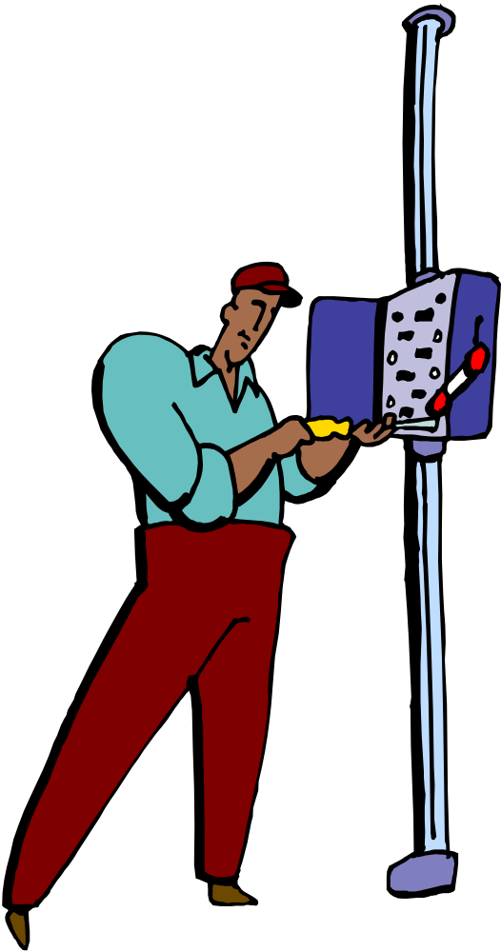
Outline
Types of valves
Components of valves
Instrumentation: on-line meters
Process control review

Slide 3
Valves, Instrumentation, and Control Learning Objectives
At the end of this section, you should be able to…
Describe the major types of valves, their operation and characteristics, and draw their standard symbols on a P&ID.
Select an appropriate valve for a specific application.
Identify the function of the major components of a valve.
Select trim and K

Slide 4
List the four most commonly measured variables and draw the symbols for those meters on a P& ID.
Describe the principals of measurement.
Define the variables involved in an PID loop and draw appropriately on a P&ID.
Define tuning.
List the common process problems that lead to unstable PID loops.

Slide 5
References
Chapter 15 in Turton et al., Analysis, Synthesis, and Design of Chemical Processes.
Process Engineers: Take Control! Cecil L. Smith. Chemical Engineering Progress. August 2000.

Slide 6
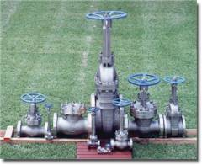
VALVES

Slide 7

Valve Types
Ball Valve
Butterfly Valve
Gate Valve
Globe Valve
Check Valve

Slide 8
Parts of a Valve
1. Closure member: part of the valve that closes flow (disk, ball, gate, etc.).
2. Actuator: means of operating the valve – hand, gear, chain wheel, motor, solenoid, pressure and flow of the media, air pressure.

Slide 9
3. End fitting: must be specified when buying the valve - butt weld end, compression flange, pipe thread, quick disconnect
4. Material: closure member, housing, seat – stainless steel
5. Packing/seals: seals stem, replaced
6. Seat: where the closure members seals against the valve housing

Slide 10
Ball Valve
Sphere with a port in a housing, rotate to expose channel.
• Applications: Flow control, pressure control, shutoff, corrosive fluids, liquids, gases, high temp.
• Advantages – low pressure drop, low leakage, small, rapid opening
• Disadvantages – seat can wear if used for throttling, quick open may cause hammer

Slide 11
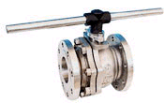
Ball Valve

Slide 12
Gate Valve
Sliding disk, perpendicular to flow
Applications: Stop valves, (not throttling), high pressure and temp, not for slurries, viscous fluids
Advantages – low pressure drop when fully open, tight seal when closed, free of contamination buildup
Disadvantages – vibration when partially open, slow response and large actuating force

Slide 13
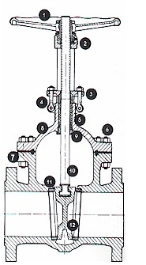
Gate Valve

Slide 14
Butterfly Valve
rotating disk on a shaft, in a housing
Low pressure, large diameter lines where leakage is unimportant
Advantages – low pressure drop, small and light weight
Disadvantages – high leakage, high actuation forces so limited to low pressures

Slide 15
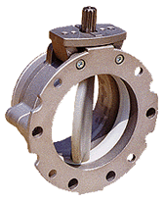
Butterfly Valve

Slide 16
Check Valves
allows flow in only one direction
Swing valve similar to butterfly except hinged along one edge rather than rotate about the diameter, used primarily for check valves.

Slide 17
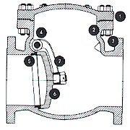
Check valve

Slide 18
Globe Valve
three types (globe, angle and Y), disc or plug moved perpendicular to flow and closes on a ring seat
Throttling, general purpose flow control valve
Advantages – faster than gate, seat less wear and tear, high pressure drop for pressure control
Disadvantage high pressure drop, require considerable power to operate (gears and levers), heavy

Slide 19
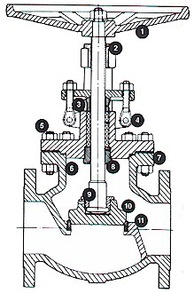
Globe Valve

Slide 20
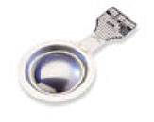
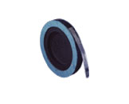
Rupture Disk
(not a valve – ruptures at a set pressure)

Slide 21
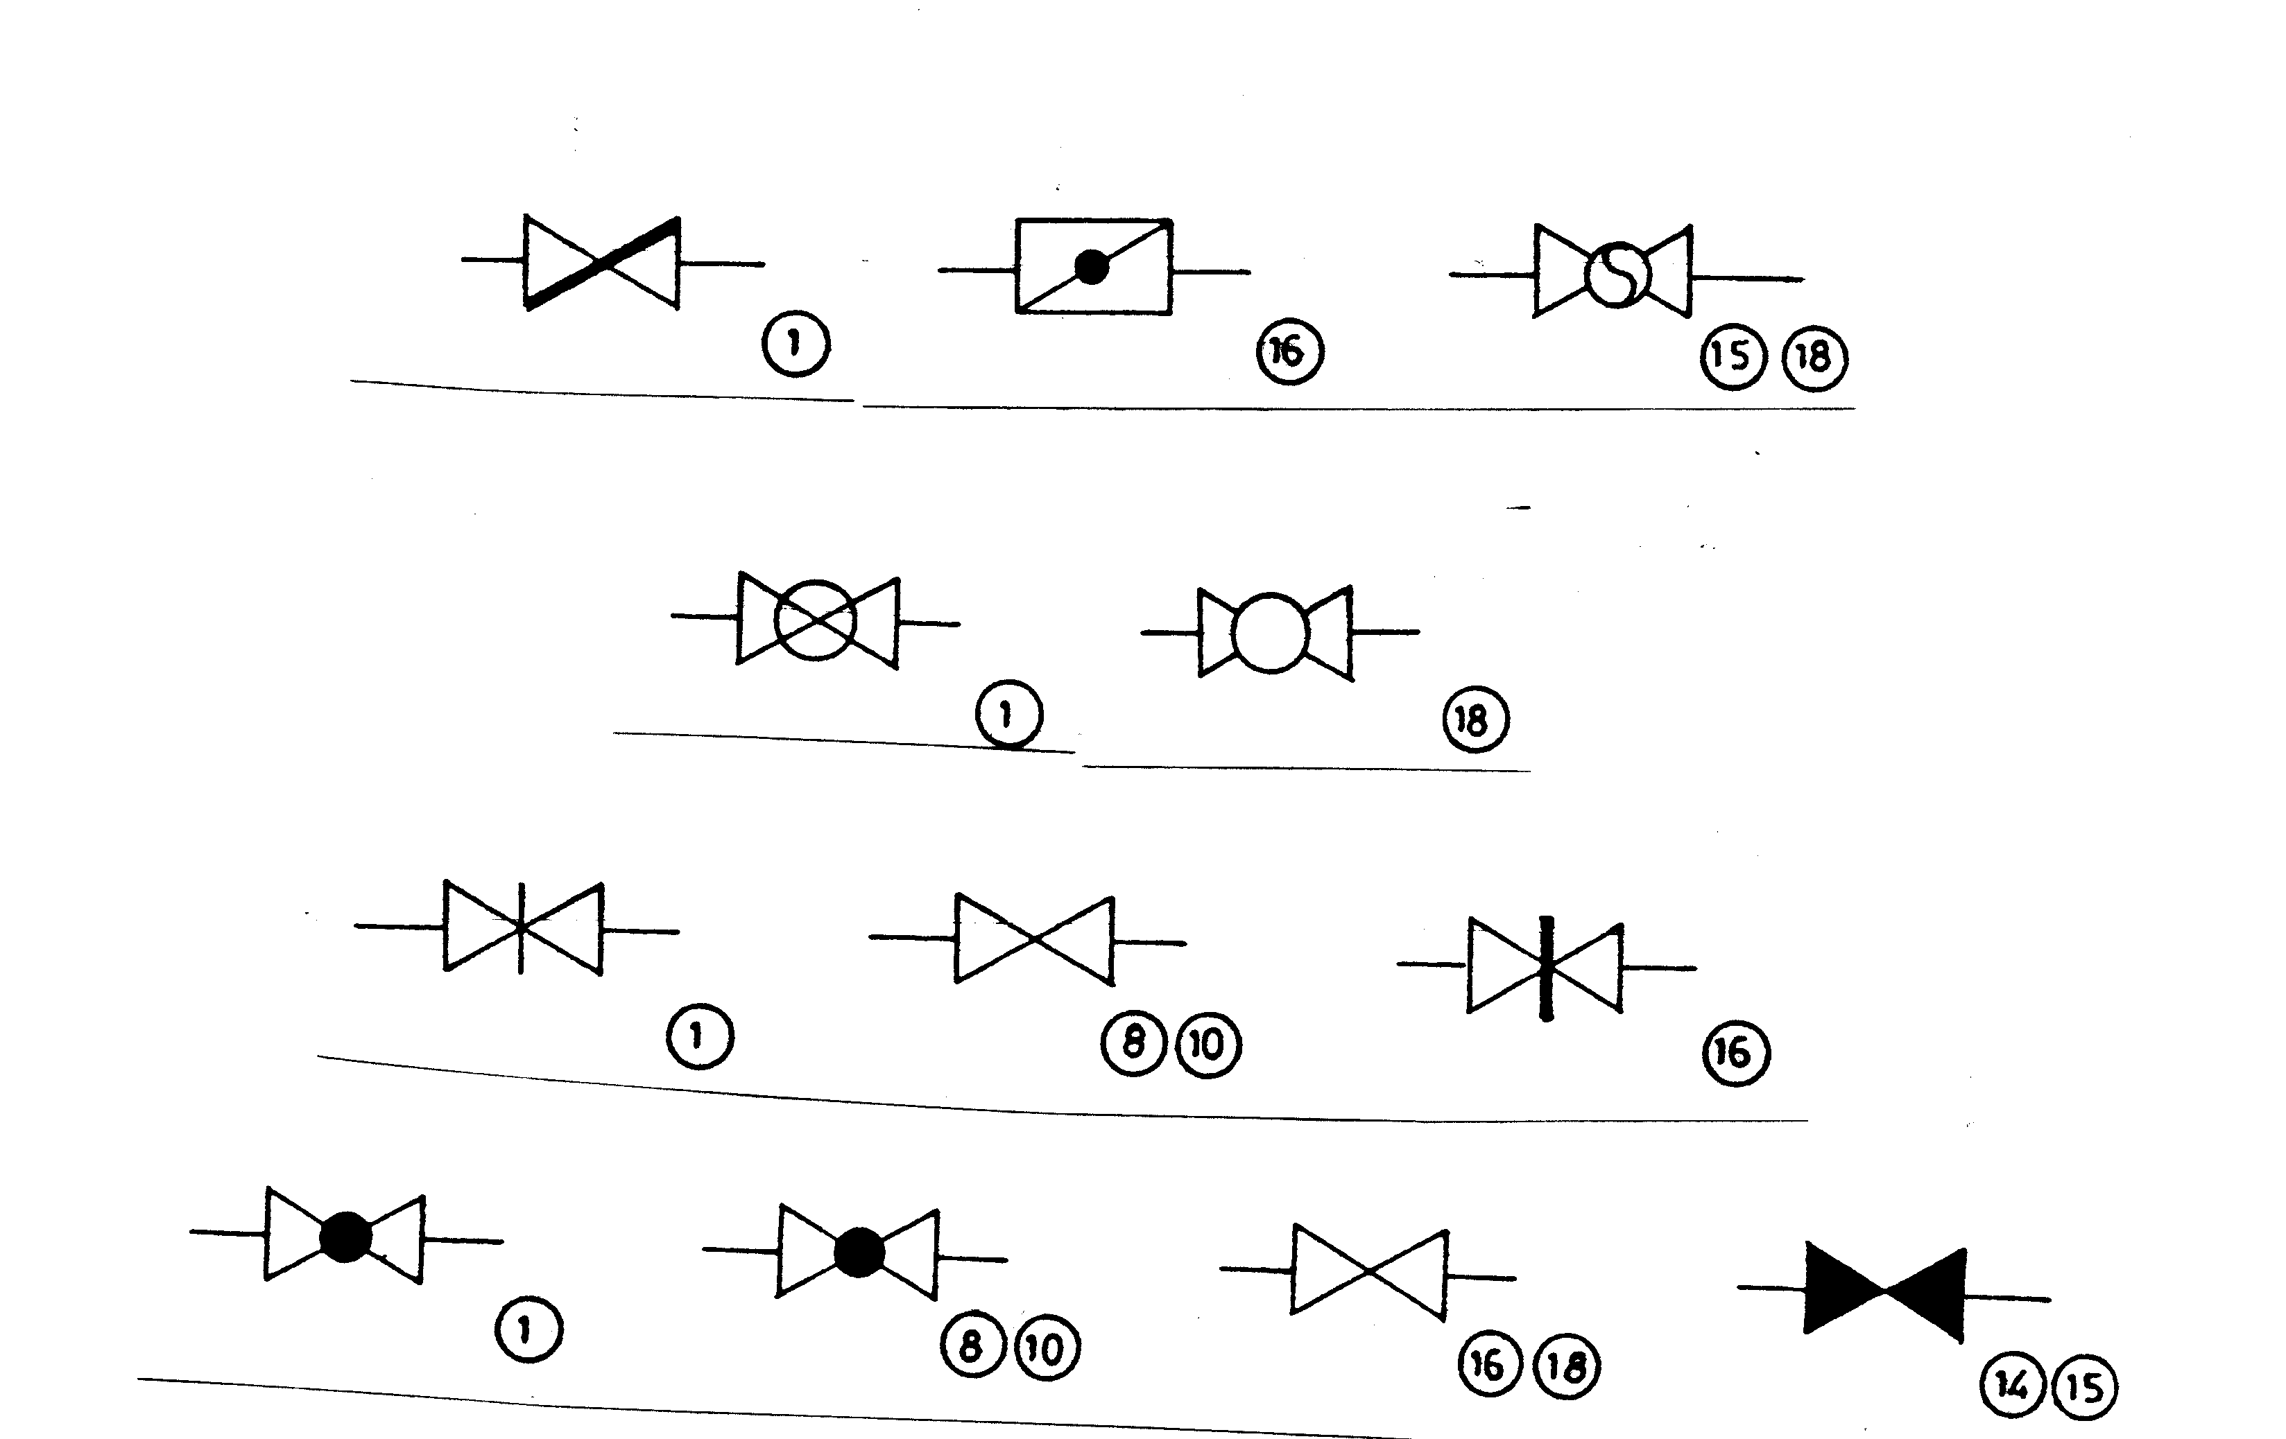
Valve Symbols
Butterfly Valve
Ball Valve
Gate Valve
Globe Valve

Slide 22
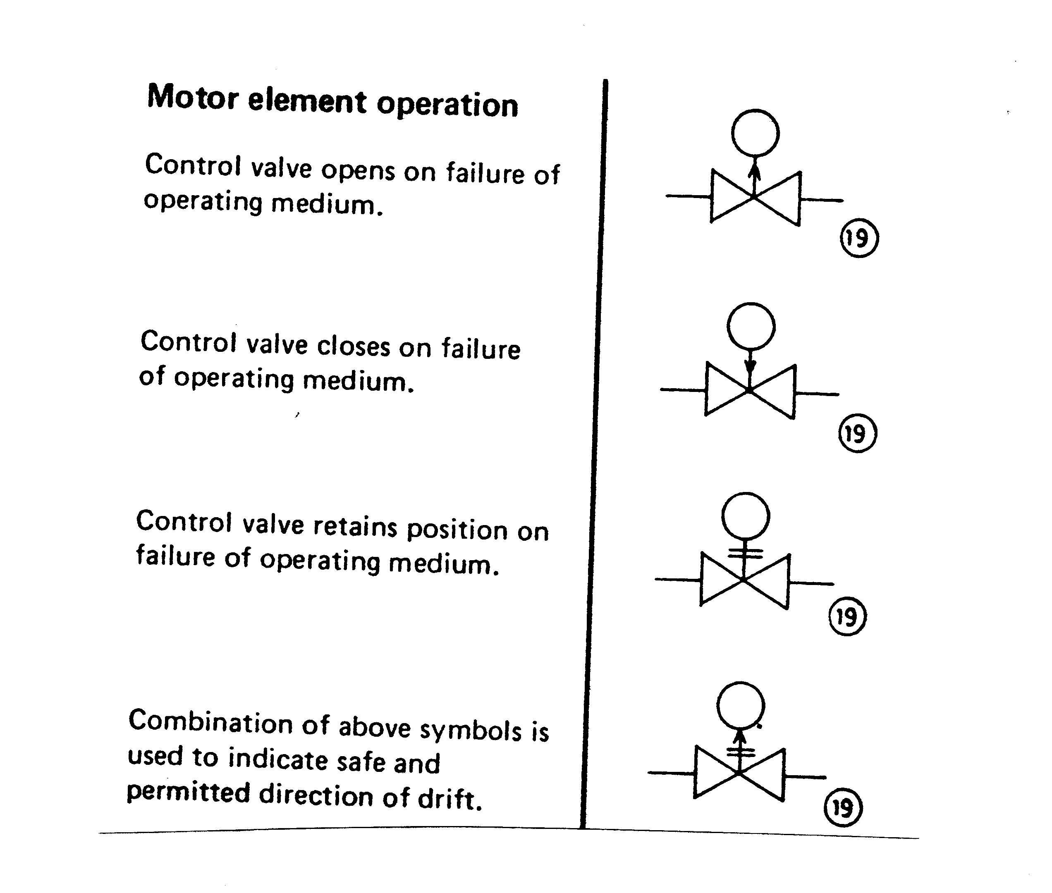

Slide 23
Instrumentation
- Form groups of two.
- List as many process conditions that can be measured on-line as you can.
- List the four most common.

Slide 24
Instrumentation
Most commonly measured process conditions: temperature, level, pressure, flow rate, pH.
Other variables include composition, moisture, specific gravity, viscosity, dissolved oxygen.

Slide 25
Temperature
Thermocouple
Two wires of different metals welded together at the end
When the junction is heated a small electric current proportional to the junction temperature is generated
Types of thermocouple refer to the types of metal – common J,H, K
Thermowell is a sleeve that the thermocouple sits in
Issues – low current, fouling of thermowell
Thermister/Resistive thermal detectors (RTD)
Consists of a resister that have a high coefficient of resistance
Resistance = f(temperature)

Slide 26
Flow Rate
Historically the most common method to measure flow rate is the orifice plate.
However, more sophisticated methods are becoming more common because they have less pressure drop.

Slide 27
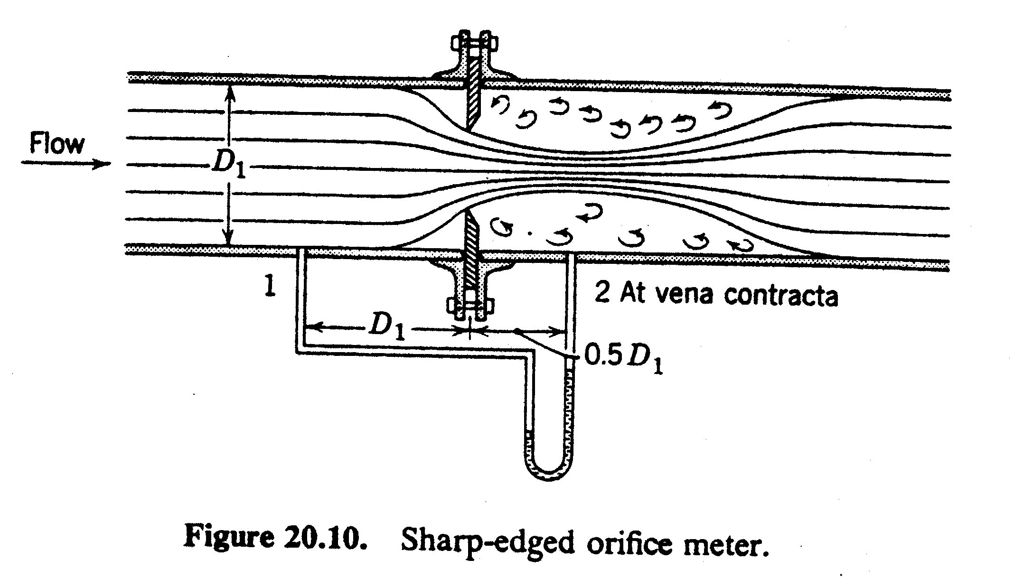
Orifice Meter

Slide 28
Calculating pressure drop across and orifice meter
ΔP (psi) = K*(ρ/1726)(velocity²)
K=orifice coefficient usually 0.6-0.8
ρ=density (lb/ft³)
velocity=velocity through the orifice ft/s
for estimation use orifice ½ of the pipe diameter
Example: assume 4 inch line, 200 gpm, orifice diameter = 2 in, orifice radius = 1 in = 0.083 ft
velocity=(200gal/min)(ft³/7.48gal)(min/60 sec)(1/pi(0.083²ft²)=20.6 f/s
ΔP (psi)=0.7*(62.4)(20.6²)/1726=10.7 psi

Slide 29
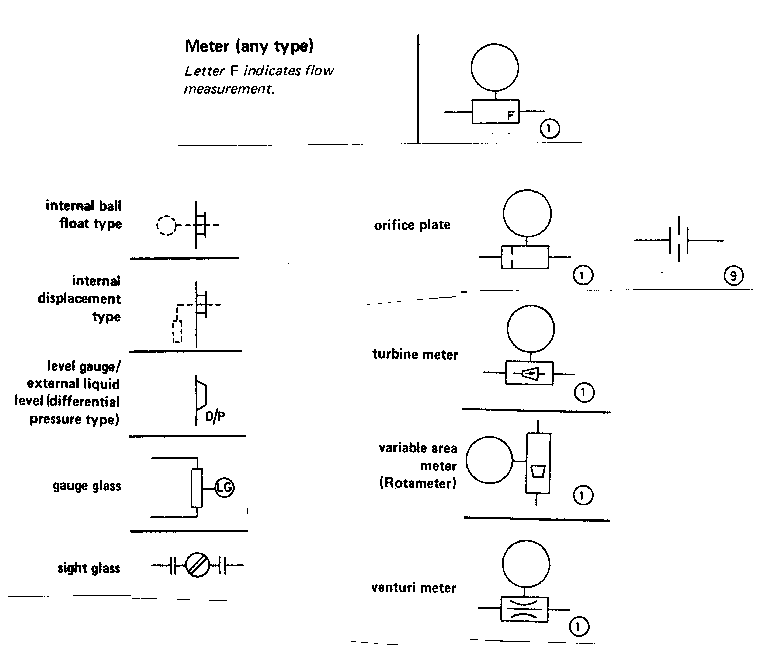
Level Meters
Flow Meters

Slide 30
Process Control: A Review
Assignment: Read the Smith article and Turton’s chapter 15 about process control.

Slide 31
Process Upsets
T, F, reaction rate, P etc. may change and effect product quality. These variables may change due to equipment failure, intentional production rate changes, cooling water changes, etc. These changes are called process upsets.

Slide 32
Controlled Variables
Controlled variables are variables that we want to maintain at constant or specified values (T, P, flow rate, level, etc.).

Slide 33
Manipulated Variables
Manipulated variables are variables that we intentionally change to maintain our controlled variable at a constant value. We often manipulate the values by opening or closing a valve.

Slide 34
Measured Variables
Measured variables are variables that we measure with a meter (often often the controlled variable or a variable that we use to calculate the controller variable).

Slide 35
Controller
A unit that reads an INPUT signal and a SET POINT, compares the two, performs a calculation on the difference, and sends out an OUTPUT signal.
Common type of controller: PID = proportional, integral, derivative

Slide 36
Controller
meter
controller
valve
INPUT
OUTPUT
SET POINT (commonly from the operator)
(Electrical or pneumatic signal indicated by dashed line.)

Slide 37
Controller Operation
If the INPUT is different than the SET POINT, the OUTPUT signal is changed.
If the INPUT signal is the same as the SET POINT, the OUTPUT signal remains the same.

Slide 38
Types of Control:
Feed Back
When the controlled variable changes or is different than the set point, the controller adjusts the manipulated variable to bring the controlled variable back to the set point value.
The controlled variable must change (be different than the set point) for control action to be taken.

Slide 39
Feed Forward
The measured variables are used to change manipulated variables before changes in the controlled variable takes place. Especially useful when there are long lag times in the process.
All factors likely to cause a change in the controlled variable must be taken into account.
Some type of model of process behavior/dynamics must be known, and the accuracy of control is directly linked to the accuracy of control.

Slide 40
Cascade
Uses controllers in series. The first controller’s output is the set point to the second controller.
Reduces lags and allows finer controls, but is more complicated than single loops.

Slide 41
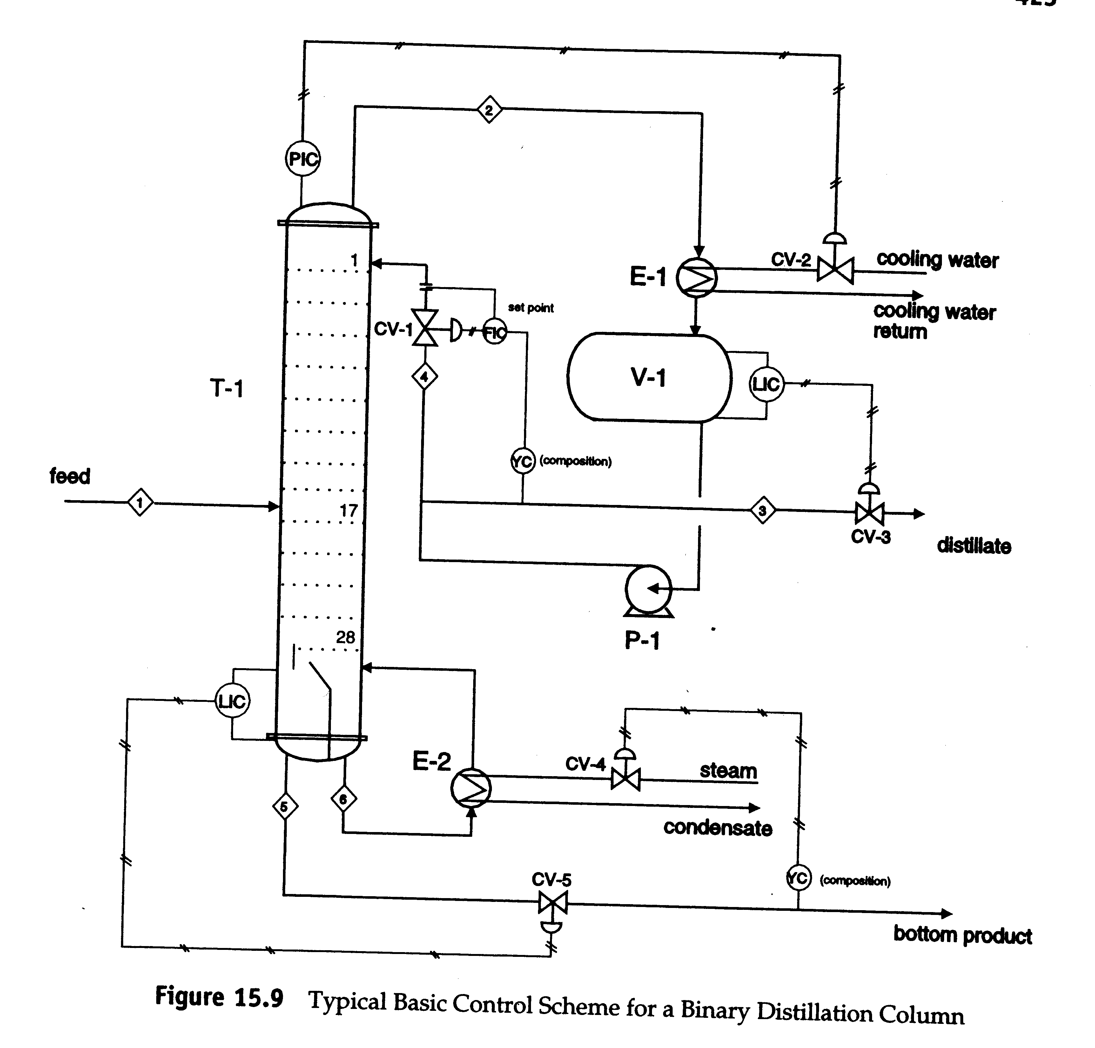
Controlled variables?
Control loops?
What happens if the light component concentration in the feed decreases?

Slide 42
Distillation Control
Purity of distillate will decrease and amount in overhead will decrease.
Valve CV-1 will open to increase reflux rate in response to concentration change.
Level in reflux drum will drop, so CV-3 will close to reduce overhead flow rate.
Pressure will decrease causing CV-2 to close and cooling water flow rate to decrease.
Level and purity in the bottoms will increase causing CV-5 to open increasing bottoms flow, and CV-4 will close reducing steam

Slide 43
Control Exercise
Form groups of two students
Develop a feedback control loops.
Draw your PFD with control loop on the board.

